Slide 1
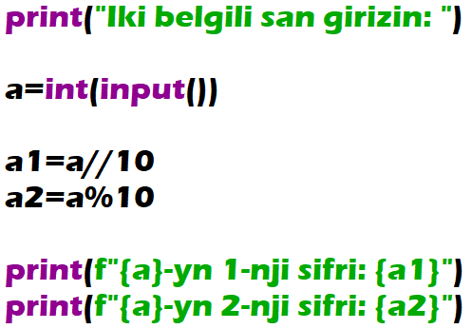
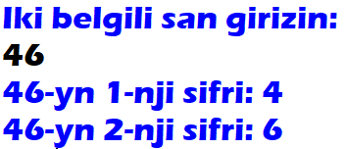
A two-digit integer is given. Output its left digit (a tens digit) and then its right digit (a ones digit). Use the operator of integer division for obtaining the tens digit and the operator of taking remainder for obtaining the ones digit.

Slide 2
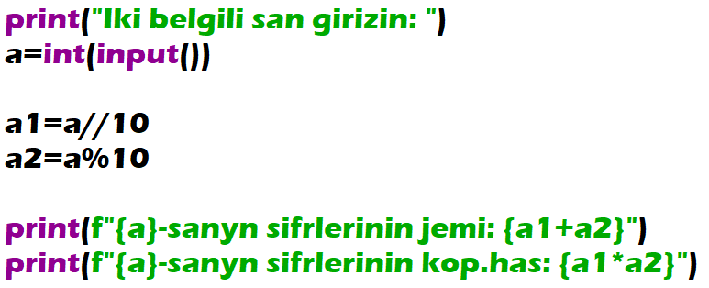
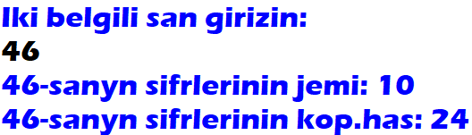
A two-digit integer is given. Find the sum and the product of its digits.

Slide 3
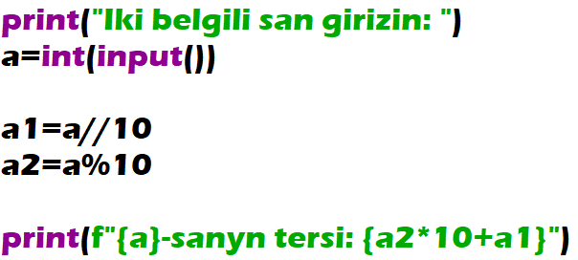
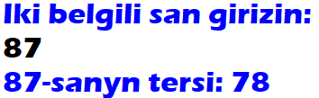
A two-digit integer is given. Output an integer obtained from the given one by exchange of its digits.

Slide 4
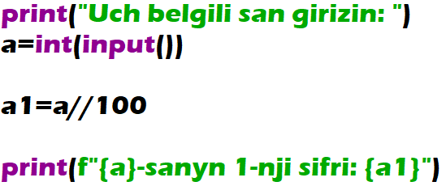
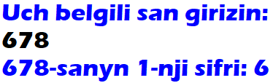
A three-digit integer is given. Using one operator of integer division find first digit of the given integer (a hundreds digit)

Slide 5
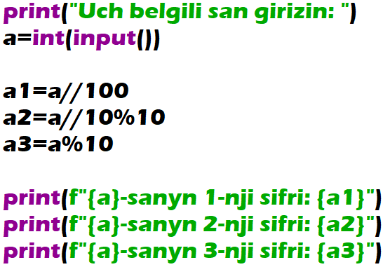
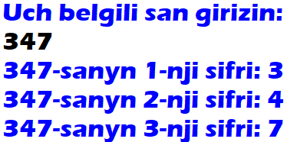
A three-digit integer is given. Output its last digit (a ones digit) and then its middle digit (a tens digit).

Slide 6
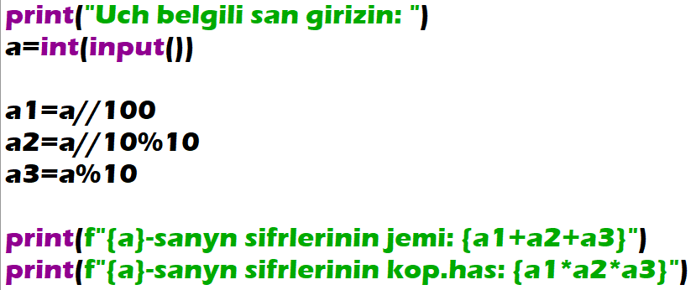
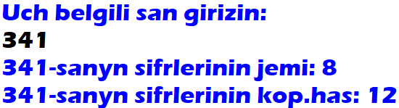
A three-digit integer is given. Find the sum and the product of its digits.

Slide 7
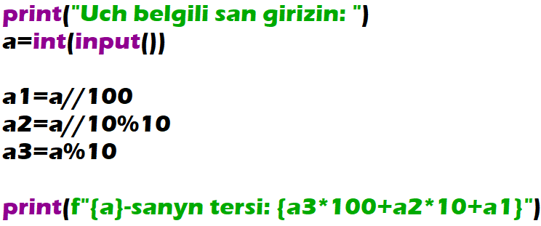
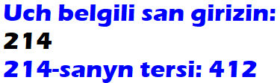
A three-digit integer is given. Output an integer obtained from the given one by reading it from right to left.

